Slide 1

What is Interaction Design?

Slide 2
What is interaction design?
Designing interactive products to support people in their everyday and working lives
      Sharp, Rogers and Preece (2002)
The design of spaces for human communication and interaction
      Winograd (1997)

Slide 3
Goals of interaction design
Develop usable products
  Usability means easy to learn, effective to use and provide an enjoyable experience
Involve users in the design process

Slide 4
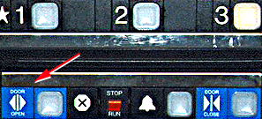
Example of bad and good design
  Elevator controls and labels on the bottom row all look the same, so it is easy to push a label by mistake instead of a control button
  People do not make same mistake for the labels and buttons on the top row. Why not?
From: www.baddesigns.com

Slide 5
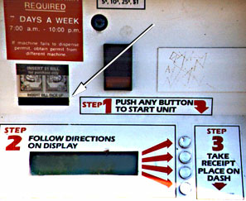
Why is this vending machine so bad?
Need to push button first to activate reader
Normally insert bill first before making selection
Contravenes well known convention
From: www.baddesigns.com

Slide 6
What to design
Need to take into account:
  Who the users are
  What activities are being carried out
  Where the interaction is taking place
Need to optimise the interactions users have with a product
  Such that they match the users activities and needs

Slide 7
Understanding users’ needs
  Need to take into account what people are good and bad at
  Consider what might help people in the way they currently do things
  Listen to what people want and get them involved
  Use tried and tested user-based methods

Slide 8


Activity
How does making a call differ when using a:
  Cell phone
  Public phone box?
Consider the kinds of user, type of activity and context of use

Slide 9
What is an interface?
?

Slide 10
Evolution of HCI ‘interfaces’
50s - Interface at the hardware level for engineers - switch panels
60-70s - interface at the programming level - COBOL, FORTRAN
70-90s - Interface at the terminal level - command languages
80s - Interface at the interaction dialogue level - GUIs, multimedia
90s - Interface at the work setting - networked systems, groupware
00s - Interface becomes pervasive
  RF tags, Bluetooth technology, mobile devices, consumer electronics, interactive screens, embedded technology

Slide 11
From HCI to Interaction Design
Human-computer interaction (HCI) is:
“concerned with the design, evaluation and implementation of interactive computing systems for human use and with the study of major phenomena surrounding them” (ACM SIGCHI, 1992, p.6)
Interaction design (ID) is:
“the design of spaces for human communication and interaction”
      Winograd (1997)
Increasingly, more application areas, more technologies and more issues to consider when designing ‘interfaces’

Slide 12
Relationship between ID, HCI and other fields
Academic
disciplines
(e.g. computer
science,
psychology)
Design practices
(e.g. graphic design)
Interaction
Design
Interdisciplinary fields
(e.g HCI, CSCW)

Slide 13
Relationship between ID, HCI and other fields
Academic disciplines contributing to ID:
  Psychology
  Social Sciences
  Computing Sciences
  Engineering
  Ergonomics
  Informatics

Slide 14
Relationship between ID, HCI and other fields
Design practices contributing to ID:
  Graphic design
  Product design
  Artist-design
  Industrial design
  Film industry

Slide 15
Relationship between ID, HCI and other fields
Interdisciplinary fields that ‘do’ interaction design:
  HCI
  Human Factors
  Cognitive Engineering
  Cognitive Ergonomics
  Computer Supported Co-operative Work
  Information Systems

Slide 16
How easy is it to work in multidisciplinary teams?
More people involved in doing interaction design the more ideas and designs generated…but…
The more difficult it can be to communicate and progress forwards the designs being created

Slide 17
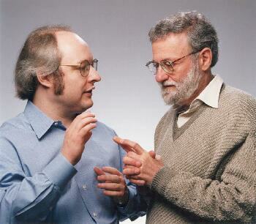


Interaction design in business
Increasing number of ID consultancies, examples of well known ones include:
  Nielsen Norman Group: “help companies enter the age of the consumer, designing human-centered products and services”
  Swim: “provides a wide range of design services, in each case targeted to address the product development needs at hand”
  IDEO: “creates products, services and environments for companies pioneering new ways to provide value to their customers”

Slide 18
What do professionals do in the ID business?
interaction designers - people involved in the design of all the interactive aspects of a product
usability engineers - people who focus on evaluating products, using usability methods and principles
web designers - people who develop and create the visual design of websites, such as layouts
information architects - people who come up with ideas of how to plan and structure interactive products
user experience designers - people who do all the above but who may also carry out field studies to inform the design of products

Slide 19
What is involved in the process of interaction design
Identify needs and establish requirements
Develop alternative designs
Build interactive prototypes that can be communicated and assessed
Evaluate what is being built throughout the process

Slide 20
Core characteristics of interaction design
users should be involved through the development of the project
specific usability and user experience goals need to be identified, clearly documented and agreed at the beginning of the project
iteration is needed through the core activities

Slide 21
Usability goals
Effective to use
Efficient to use
Safe to use
Have good utility
Easy to learn
Easy to remember how to use

Slide 22




Activity on usability
How long should it take and how long does it actually take to:
  use a VCR to play a video?
  use a VCR to pre-record two programs?
  use an authoring tool to create a website?

Slide 23
User experience goals
  Satisfying - rewarding
  Fun - support creativity
  Enjoyable - emotionally fulfilling
  Entertaining …and more
  Helpful
  Motivating
  Aesthetically pleasing
  Motivating

Slide 24
Usability and user experience goals
How do usability goals differ from user experience goals?
Are there trade-offs between the two kinds of goals?
  e.g. can a product be both fun and safe?
How easy is it to measure usability versus user experience goals?

Slide 25
Design principles
Generalizable abstractions for thinking about different aspects of design
The do’s and don’ts of interaction design
What to provide and what not to provide at the interface
Derived from a mix of theory-based knowledge, experience and common-sense

Slide 26

Visibility
• This is a control panel for an elevator.
• How does it work?
• Push a button for the floor you want?
• Nothing happens. Push any other button? Still nothing. What do you need to do?
It is not visible as to what to do!
From: www.baddesigns.com

Slide 27
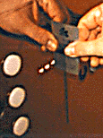
Visibility
      …you need to insert your room card in the slot by the buttons to get the elevator to work!
      How would you make this action more visible?
      • make the card reader more obvious
      • provide an auditory message, that says what to do (which language?)
      • provide a big label next to the card reader that flashes when someone enters
  • make relevant parts visible
  • make what has to be done obvious

Slide 28
Feedback
Sending information back to the user about what has been done
Includes sound, highlighting, animation and combinations of these
  e.g. when screen button clicked on provides sound or red highlight feedback:
“ccclichhk”

Slide 29
Constraints
Restricting the possible actions that can be performed
Helps prevent user from selecting incorrect options
Three main types (Norman, 1999)
  physical
  cultural
  logical

Slide 30
Physical constraints
Refer to the way physical objects restrict the movement of things
  E.g. only one way you can insert a key into a lock
How many ways can you insert a CD or DVD disk into a computer?
How physically constraining is this action?
How does it differ from the insertion of a floppy disk into a computer?

Slide 31
Logical constraints
Exploits people’s everyday common sense reasoning about the way the world works
An example is they logical relationship between physical layout of a device and the way it works as the next slide illustrates

Slide 32
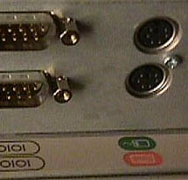
Logical or ambiguous design?
Where do you plug the mouse?
Where do you plug the keyboard?
top or bottom connector?
Do the color coded icons help?
From: www.baddesigns.com

Slide 33

How to design them more logically
(i) A provides direct adjacent mapping between icon and connector
(ii) B provides color coding to associate the connectors with the labels
From: www.baddesigns.com

Slide 34

Cultural constraints
Learned arbitrary conventions
like red triangles for warning
Can be universal or culturally specific

Slide 35

Which are universal and which are culturally-specific?

Slide 36
Mapping
Relationship between controls and their movements and the results in the world
Why is this a poor mapping of control buttons?

Slide 37
Mapping
Why is this a better mapping?
The control buttons are mapped better onto the sequence of actions of fast rewind, rewind, play and fast forward

Slide 38
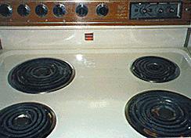
Activity on mappings
  Which controls go with which rings (burners)?
A
B
C
D

Slide 39

Why is this a better design?

Slide 40
Consistency
Design interfaces to have similar operations and use similar elements for similar tasks
For example:
  always use ctrl key plus first initial of the command for an operation – ctrl+C, ctrl+S, ctrl+O
Main benefit is consistent interfaces are easier to learn and use

Slide 41
When consistency breaks down
What happens if there is more than one command starting with the same letter?
  e.g. save, spelling, select, style
Have to find other initials or combinations of keys, thereby breaking the consistency rule
  E.g. ctrl+S, ctrl+Sp, ctrl+shift+L
Increases learning burden on user, making them more prone to errors

Slide 42
Internal and external consistency
Internal consistency refers to designing operations to behave the same within an application
  Difficult to achieve with complex interfaces
External consistency refers to designing operations, interfaces, etc., to be the same across applications and devices
  Very rarely the case, based on different designer’s preference

Slide 43
Keypad numbers layout
A case of external inconsistency
(a) phones, remote controls
(b) calculators, computer keypads
1
2
3
7
8
9
4
5
6
4
5
6
7
8
9
1
2
3
0
0

Slide 44
Affordances: to give a clue
Refers to an attribute of an object that allows people to know how to use it
  e.g. a mouse button invites pushing, a door handle affords pulling
Norman (1988) used the term to discuss the design of everyday objects
Since has been much popularised in interaction design to discuss how to design interface objects
  e.g. scrollbars to afford moving up and down, icons to afford clicking on

Slide 45
What does ‘affordance’ have to offer interaction design?
Interfaces are virtual and do not have affordances like physical objects
Norman argues it does not make sense to talk about interfaces in terms of ‘real’ affordances
Instead interfaces are better conceptualised as ‘perceived’ affordances
  Learned conventions of arbitrary mappings between action and effect at the interface
  Some mappings are better than others

Slide 46

Activity
  Physical affordances:
    How do the following physical objects afford? Are they obvious?

Slide 47
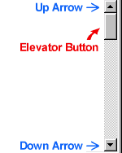


Activity
  Virtual affordances
    How do the following screen objects afford?
    What if you were a novice user?
    Would you know what to do with them?

Slide 48
Usability principles
Similar to design principles, except more prescriptive
Used mainly as the basis for evaluating systems
Provide a framework for heuristic evaluation

Slide 49
Usability principles (Nielsen 2001)
Visibility of system status
Match between system and the real world
User control and freedom
Consistency and standards
Help users recognize, diagnose and recover from errors
Error prevention
Recognition rather than recall
Flexibility and efficiency of use
Aesthetic and minimalist design
Help and documentation

Slide 50
Key points
ID is concerned with designing interactive products to support people in their everyday and working lives
ID is multidisciplinary, involving many inputs from wide-reaching disciplines and fields
ID is big business even after the dot.com crash!

Slide 51
Key points
ID involves taking into account a number of interdependent factors including context of use, type of task and kind of user
Need to strive for usability and user experience goals
Design and usability principles are useful heuristics for analyzing and evaluating interactive products

Slide 52
Group | Definition | Importance | Design principle | Creativity
1 | 5 | 5 | 5 | 5
2 | 5 | 5 | 5 | 5
3 | 5 | 5 | 5 | 5
4 | 5 | 5 | 5 | 5
5 | 5 | 5 | 5 | 5
6 | 5 | 5 | 5 | 5
7 | 5 | 5 | 5 | 5

